Slide 1
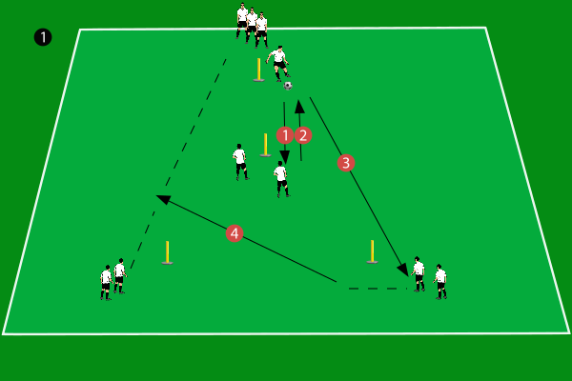
sample fromo builders
1 | 2 | 3
3 | 4

